Slide 1
Constants
Part 2
Creative Commons Attribution-NonCommercial-ShareAlike 3.0 Unported License. http://creativecommons.org/licenses/by-nc-sa/3.0/
Written by Rachel J. Morris, last updated 2016-03-06

Slide 2

Previously, we've talked about...
Constant variables
Const pass-by-reference

Slide 3
But now...
Now that we've covered classes, there are more ways we can use the const keyword.
We can make member functions of a class const, in order to ensure that member variables are not changed.
We can also return references from functions, and in some cases we may want to return a const reference.
We might also want to create a pointer to some address, but ensure the value at that address cannot change.

Slide 4
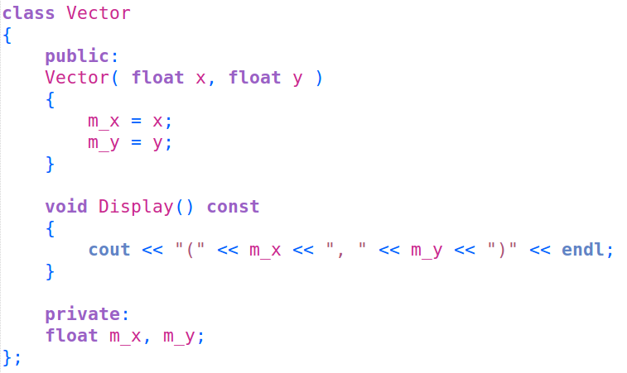
Const Functions
When declaring a member function within a class, if we
do not want any member variables to change,
we can define the function as const by adding
the const keyword to the end of the signature.
Because this function is const, it can output the values of
m_x and m_y,
but it cannot change them – otherwise, a compile error will occur.

Slide 5
Const Functions
It is good to utilize the const keyword any time that you're writing a function where class members should not be changed, as good programming practice.
Because this function is const, it can output the values of
m_x and m_y,
but it cannot change them – otherwise, a compile error will occur.

Slide 6
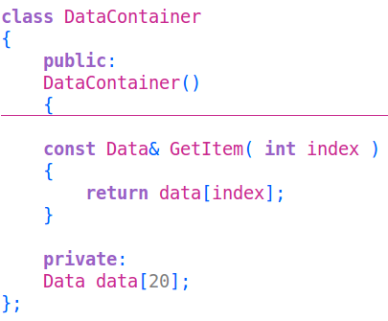
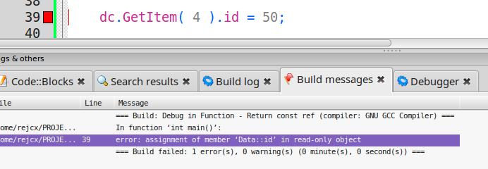
Returning Const
With some functions, you may return a reference to an item. However, while you may want to allow access to an item by returning a reference to it, you might not want anything externally to actually change the value.
You can return a const variable from a function.
By returning something as a const reference, we can ensure that the compiler will throw an error if we try to modify that referenced item.

Slide 7
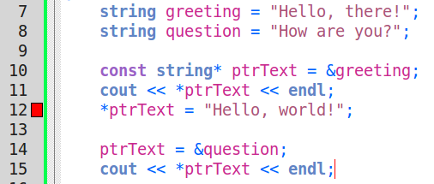

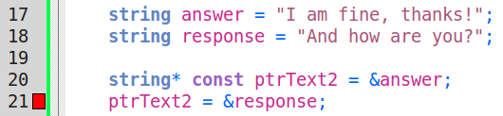
Const and Pointers
If we declare a pointer with const before the datatype*, then we can still change what our pointer is pointing to, but we cannot change the data it is pointing at.
If we declare a pointer with const after the datatype*, we are saying that we cannot change the address that the pointer is pointing to.
The pointer must be assigned at declaration.

Slide 8

Review
Utilizing const is a good way to enforce design decisions, and have the compiler itself police these decisions – if something is written that violates your design, the program will not compile.
Some ways to utilize const are...
const variables
Pass-by-const-reference
Return const-reference
Const-pointer
Pointer-to-const

